Slide 1
Wireless Digital Communications
Topic 5
Adaptive Modulation

Slide 2
基本思路
CSI:
Variable Power Variable Rate:

Slide 3

基本思路
Channel Inversion:
subject to

Slide 4
Nonadaptive Modulation

Slide 5
Adaptive Modulation
Change modulation relative to fading
Parameters to adapt:
Constellation size
Transmit power
Instantaneous BER
Symbol time
Coding rate/scheme
Optimization criterion:
Maximize throughput
Minimize average power
Minimize average BER
Only 1-2 degrees of freedom needed for good performance

Slide 6
Adaptive Modulation

Slide 7
Variable-Rate Techniques (Variable Constellation Size)
Used for LTE Downlink, GSM, IS-136，EDGE, 802.11a

Slide 8
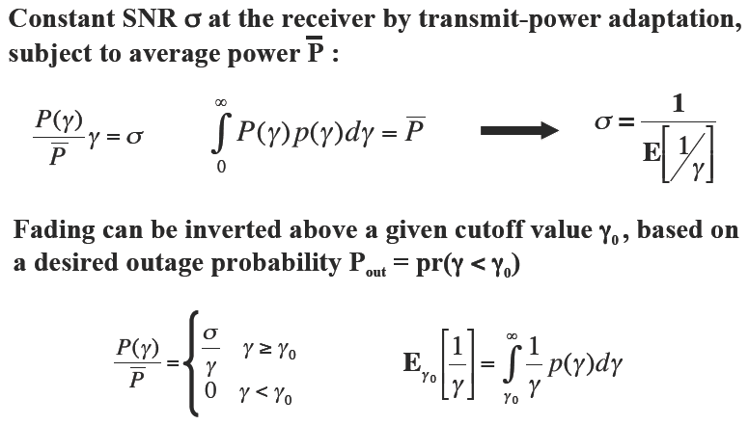
Variable-Power Techniques

Slide 9
Variable-Power Techniques

Slide 10
Spectral Efficiency for Channel Inversion with Fixed Rate
For fixed BER and channel SNR distribution, spectral efficiency
is fixed, and therefore, average SE is the same as instantaneous SE,
which is different from the optimal adaptive scheme.

Slide 11
Spectral Efficiency for Channel Inversion with Fixed Rate

Slide 12
A Practical Scheme for Power Control
For LTE Uplink

Slide 13
Variable-Rate Variable-Power MQAM
log₂ M(γ) Bits
One of the
M(γ) Points
To Channel
Point
Selector
M(γ)-QAM
Modulator
Power: P(γ)
Uncoded
Data Bits
Delay
γ(t)
γ(t)
BSPK
4-QAM
16-QAM
Goal: Optimize P(γ) and M(γ) to maximize R=Elog[M(γ)]

Slide 14
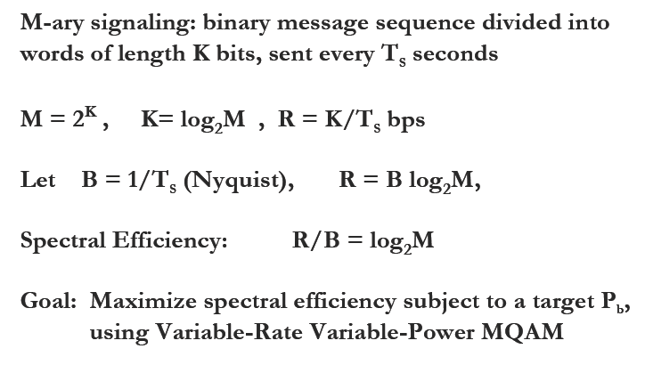
Variable-Rate Variable-Power MQAM

Slide 15
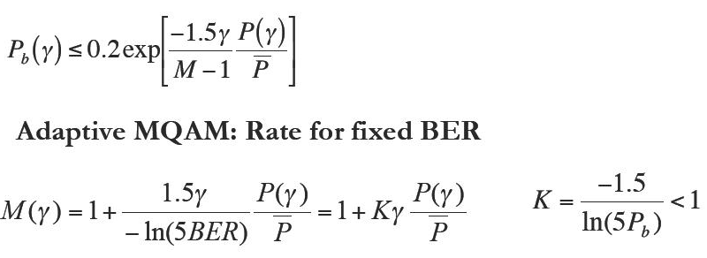
Optimization Formulation

Slide 16
Optimization Formulation

Slide 17
Optimal Adaptive Scheme
This is the same power adaptation policy that achieves capacity,
with P(γ) replaced with KP(γ). Optismum policy is water-filling.
γ

Slide 18
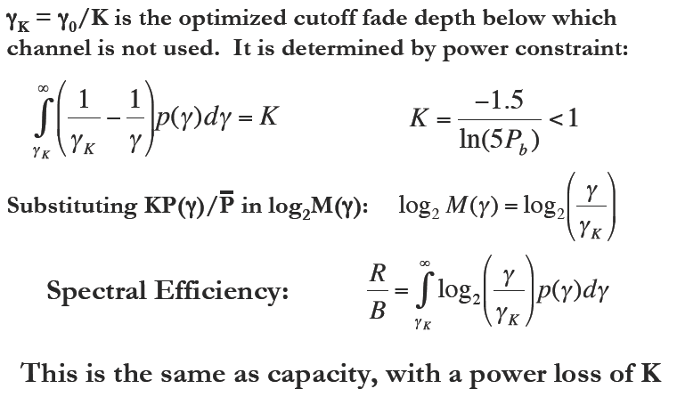
Optimal Adaptive Scheme

Slide 19
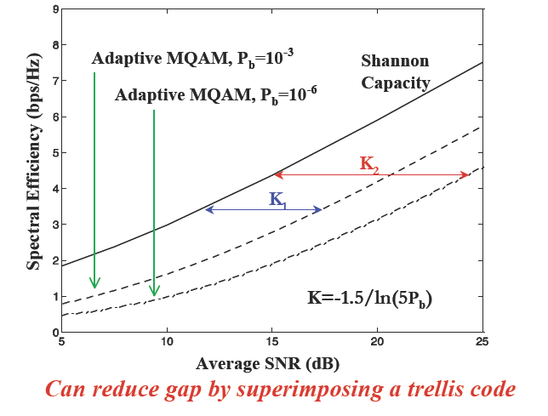
Spectral Efficiency (Rayleigh Fading)

Slide 20
Spectral Efficiency for Different Schemes (Rayleigh Fading)

Slide 21
Example 4.4

Slide 22
Example 4.4

Slide 23
Example 4.4

Slide 24
Compare Adaptive QAM (Pb=10^-3)with Example 4.4

Slide 25
Discrete-Rate Adaptation

Slide 26
Constellation Restriction
Restrict M_{D}(γ) to {M₀=0,…,M_{N}}.
Let M(γ)=γ/γ_{Κ}*, where γ_{Κ}* is later optimized.
Set M_{D}(γ) to max_{j} M_{j}: M_{j} ≤ M(γ).
Region boundaries are γ_{j}=M_{j}γ_{Κ}*, j=0,…,N
Power control maintains target BER
M₃
M(γ)=γ/γ_{Κ}*
M_{D}(γ)
M₂
M₃
M₂
M₁
M₁
0
Outage
γ₀
γ₁=M₁γ_{K}*
γ₂
γ₃
γ

Slide 27
Constellation Restriction

Slide 28
Power Adaptation

Slide 29
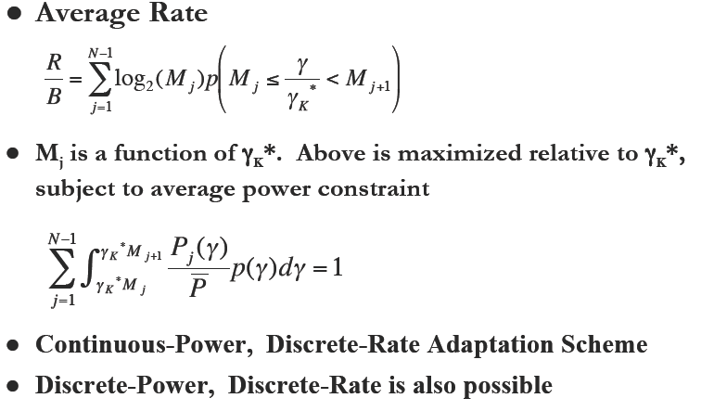
Average Rate

Slide 30
Rate and Power Adaptation-Five Regions

Slide 31
Efficiency in Log-Normal Shadowing
Spectral Efficiency (bps/Hz)
Average SNR (dB)

Slide 32
Channel Estimation Error and Delay
right side derived by substituting

Slide 33
Channel Estimation Error and Delay

Slide 34
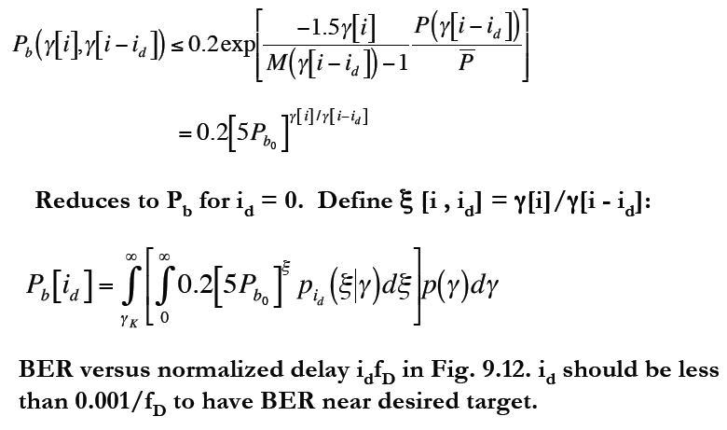
Channel Estimation Error and Delay

Slide 35
Main Points
Adaptive modulation varies modulation parameters relative to fading to improve performance
Adaptive MQAM uses capacity-achieving power and rate adaptation, with power penalty K
Adaptive MQAM comes within 5-6dB of capacity
Discretizing the constellation size results in negligible performance loss
Constellation cannot be updated faster than 10s to 100s of symbol times: OK for most Dopplers
Estimation error and delay lead to irreducible error floors

Slide 36
Ex. 9.8(a,b), 9.9(a,b)

